Slide 1
Topic 4: AVL Trees
COMP2003J: Data Structures and Algorithms 2
Dr. David Lillis (david.lillis@ucd.ie)
Beijing-Dublin International College
Further Reading: Goodrich and Tamassia (6th Edition), Section 11.3

Slide 2
AVL Tree Definition
AVL trees are an example of a self-balancing binary search tree.
Named after inventors - Adelson-Velsky and Landis - in 1962.
AVL trees must satisfy the height-balance property:
For every internal node v of T, the heights of the children of v can differ by at most 1.
AVL trees have expected performance O(log n).
An example of an AVL tree where the heights are shown next to the nodes.

Slide 3
Insertion in an AVL Tree
AVL trees are binary search trees.
Insertion is the same as in a binary search tree.
We simply locate the relevant external node and expand it.
Because AVL trees are balanced:
The expected performance of this operation is O(log n)
Example: Add 62 to this tree…
44
17
78
32
50
88
48

Slide 4
Insertion in an AVL Tree
AVL trees are binary search trees.
Insertion is the same as in a binary search tree.
We simply locate the relevant external node and expand it.
Because AVL trees are balanced:
The expected performance of this operation is O(log n)
Example: Add 62 to this tree…
44
17
78
32
50
88
48
62

Slide 5
Insertion in an AVL Tree
The key difference is that, after insertion, we must check that the height-balance property still holds.
To do this, we search upwards from the newly inserted node.
For each node we visit, we compare the height of its children.
If the difference in height between the two children is greater than 1, the tree is said to be unbalanced!
44
17
78
2
32
50
88
1
1
48
62

Slide 6
Insertion in an AVL Tree
The key difference is that, after insertion, we must check that the height-balance property still holds.
To do this, we search upwards from the newly inserted node.
For each node we visit, we compare the height of its children.
If the difference in height between the two children is greater than 1, the tree is said to be unbalanced!.
44
3
17
78
2
1
32
50
88
1
1
48
62

Slide 7
Insertion in an AVL Tree
The key difference is that, after insertion, we must check that the height-balance property still holds.
To do this, we search upwards from the newly inserted node.
For each node we visit, we compare the height of its children.
If the difference in height between the two children is greater than 1, the tree is said to be unbalanced!.
4
44
2
3
17
78
2
1
32
50
88
1
1
48
62
The tree is balanced!

Slide 8
Insertion in an AVL Tree
Lets have another go by inserting 54:
44
17
78
32
50
88
48
62

Slide 9
Insertion in an AVL Tree
Now, we do the balance check:
44
17
78
32
50
88
48
62
54

Slide 10
Insertion in an AVL Tree
Now, we do the balance check:
44
Unbalanced Node!
17
78
3
1
32
50
88
1
2
48
62
1
54

Slide 11
Insertion in an AVL Tree
Let z be the first unbalanced node encountered while travelling up the tree from the newly inserted node.
Also, let y be the child of z with the larger height, and let x be the child of y with the larger height.
Lets apply this labeling to the previous example.
44
17
78
3
1
32
50
88
1
2
48
62
1
54

Slide 12
Insertion in an AVL Tree
Because z is imbalanced, we invoke the restructure(x) operation.
This operation performs a re-stucturing of the sub tree rooted at z.
We pass in x because it is easy to work out y and z.
The restructuring process is known as trinode restructuring.
After inserting, one restructuring (if necessary) will be enough to rebalance the whole tree.
44
z
17
78
y
32
50
88
x
48
62
54

Slide 13
Trinode Restructuring
let (a,b,c) be an inorder listing of x, y, z (i.e. a is smallest value, followed by b, followed by c).
perform the rotations needed to make b the topmost node of the three
(other two cases are symmetrical)
a=z
a=z
case 2: double rotation
(a right rotation of c around b, then a left rotation of a around b)
T₀
b=y
T₀
c=y
T₁
c=x
b=x
T₃
T₂
T₃
b=y
T₁
T₂
b=x
a=z
c=x
a=z
c=y
case 1: single rotation
(a left rotation of a around b)
T₀
T₁
T₂
T₃
T₀
T₁
T₂
T₃

Slide 14
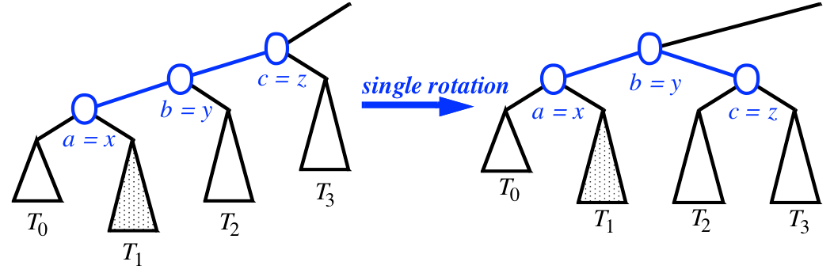
Single Rotations

Slide 15
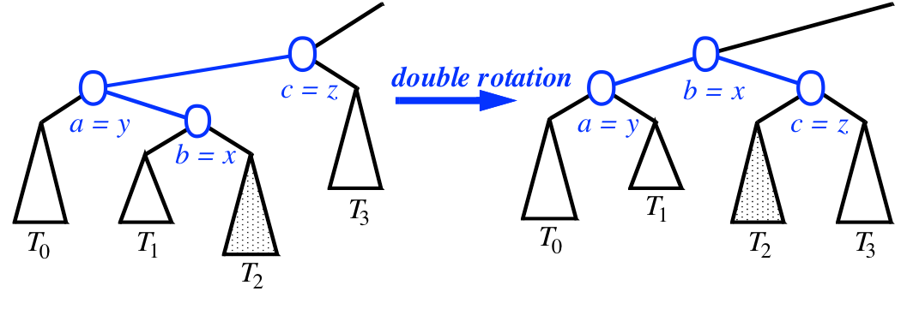
Double Rotations

Slide 16
Insertion in an AVL Tree
To restructure the subtree rooted at z, we will make b (62) the root of the subtree, with a (50) as its left child and c (78) as its right child.
44
c=z
17
78
a=y
32
50
88
b=x
48
62
54

Slide 17
Insertion in an AVL Tree
The subtrees attached to these nodes will be added as children in the same left-to-right order as before.
44
c
17
78
a
32
50
88
b
48
62
T₃
T₀
54
T₂
T₁

Slide 18
Insertion in an AVL Tree
First rotation: left rotation of a around b
(to make a a child of b).
44
c
44
c
17
78
17
78
a
b
32
50
88
32
62
88
b
48
62
T₃
a
50
T₃
T₂
T₀
54
T₂
48
54
T₁
T₀
T₁

Slide 19
Insertion in an AVL Tree
Second rotation: right rotation of c around b (to make c the right child of b).
Note that T₀, T₁, T₂ and T₃ are in the same order as before
44
c
17
78
44
b
b
32
62
88
17
62
a
c
a
T₃
32
50
78
50
T₂
54
48
54
88
48
T₂
T₀
T₁
T₀
T₁
T₃

Slide 20
Insertion in an AVL Tree
This subtree is now balanced
44
3
17
62
2
2
32
50
78
48
54
88

Slide 21
Insertion in an AVL Tree
44
General rule:
Make b (middle value) the root of the subtree being restructured.
Make a (smallest value) the left child of b and make T₀ and T₁ its children.
Make c (largest value) the right child of b and make T₂ and T₃ its children.
b
17
62
a
c
32
50
78
48
54
88
T₂
T₀
T₁
T₃
where (T₀, T₁, T₂, T₃) are the subtrees of the nodes to be restructured, named in left-to-right order.

Slide 22
Removal from an AVL Tree
Removal begins as in a binary search tree, which means the node removed will become an empty external node.
Note that we may have to swap two values before we remove the node (if the value to be removed was stored in a node with two internal children).
In contrast with insertion, its parent, w, becomes the starting point for performing the balance check.
Example: Delete 32 from the following tree
44
17
62
32
50
78
48
54
88

Slide 23
Removal from an AVL Tree
Removal begins as in a binary search tree, which means the node removed will become an empty external node.
In contrast with insertion, its parent, w, becomes the starting point for performing the balance check.
Example: Delete 32 from the following tree
44
17
62
50
78
48
54
88

Slide 24
Removal from an AVL Tree
Removal begins as in a binary search tree, which means the node removed will become an empty external node.
In contrast with insertion, its parent, w, becomes the starting point for performing the balance check.
Example: Now search for an imbalance…
44
Unbalanced Node!
1
3
17
62
50
78
48
54
88

Slide 25
Rebalancing after a Removal
Let z be the first unbalanced node encountered while traveling up the tree from w,
Also, let y be the child of z with the larger height, and let x be the child of y with the larger height.
We perform restructure(x) to restore balance at z.
z
62
44
y
44
78
17
62
x
17
50
88
50
78
48
54
48
54
88

Slide 26
Rebalancing after a Removal
As this restructuring may upset the balance of another node higher in the tree, we must continue checking for balance until the root of T is reached…
In this case, 62 is the root, so we have balanced the tree!
62
44
78
17
50
88
48
54

Slide 27
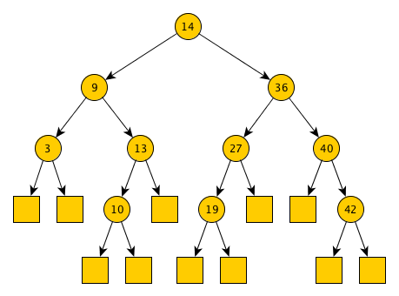
Typical Exam Question
Assume that the tree in Figure 1 is an AVL Tree. Draw the state of the tree after performing the following operations. In your answer, you should show the tree’s state after each operation, and indicate any restructuring that is required.
Insert 20
Insert 29
Remove 3
Remove 20
Insert 12
Figure 1

Slide 28
Interactive AVL Tree
https://visualgo.net/bst
The option at the top allows you to switch between a Binary Search Tree and an AVL Tree.
This is slightly different to what we have seen in class in that it does not show empty external nodes in the tree.

